Slide 1


SMART INDIAHACKATHON 2026
TITLE PAGE
Problem Statement ID – SIH26038 ProblemStatementTitle - Explainable AI for Diabetic Retinopathy Screening in Rural India
Theme - MedTech / BioTech / HealthTech PS Category - Software
Team ID - 116
Team Name : CODE RED

Slide 2

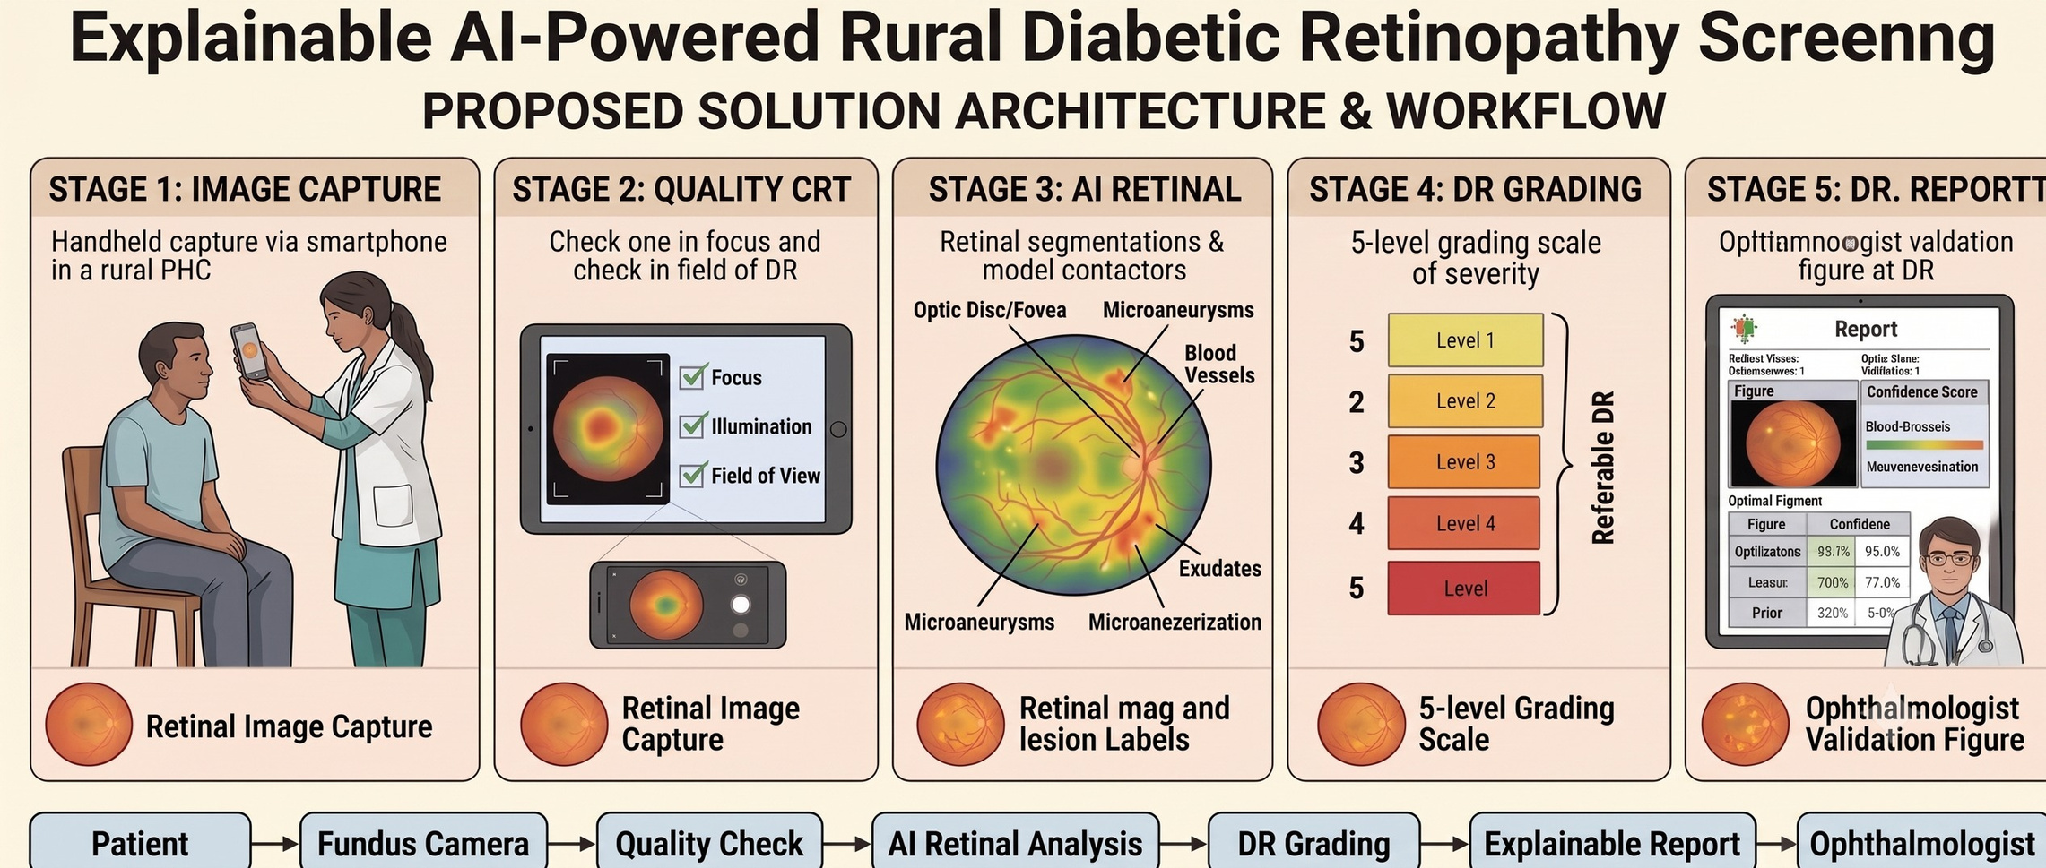
CODE RED
IDEA TITLE

Slide 3
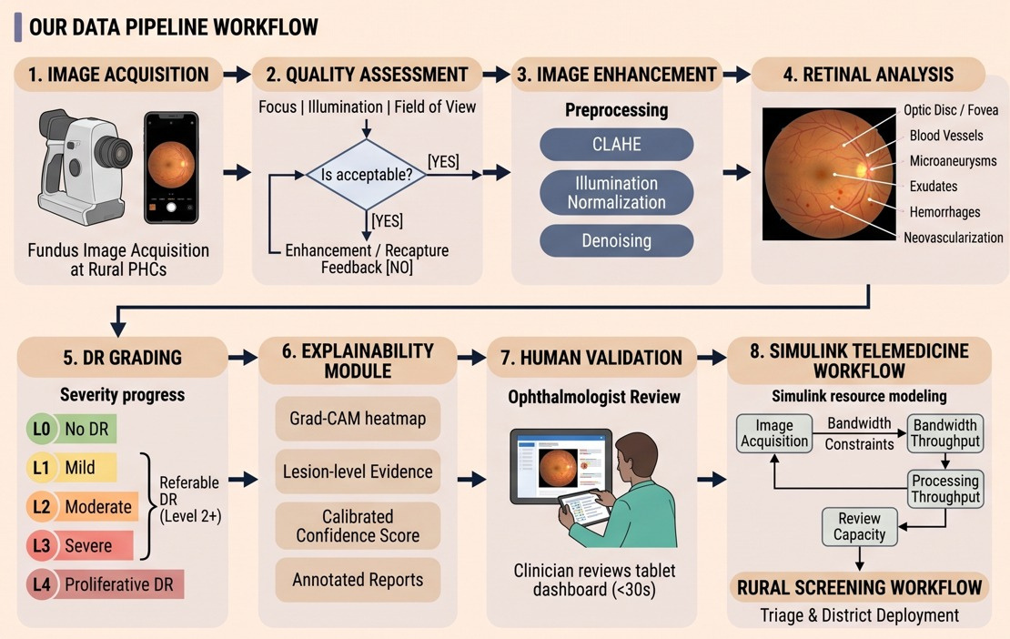
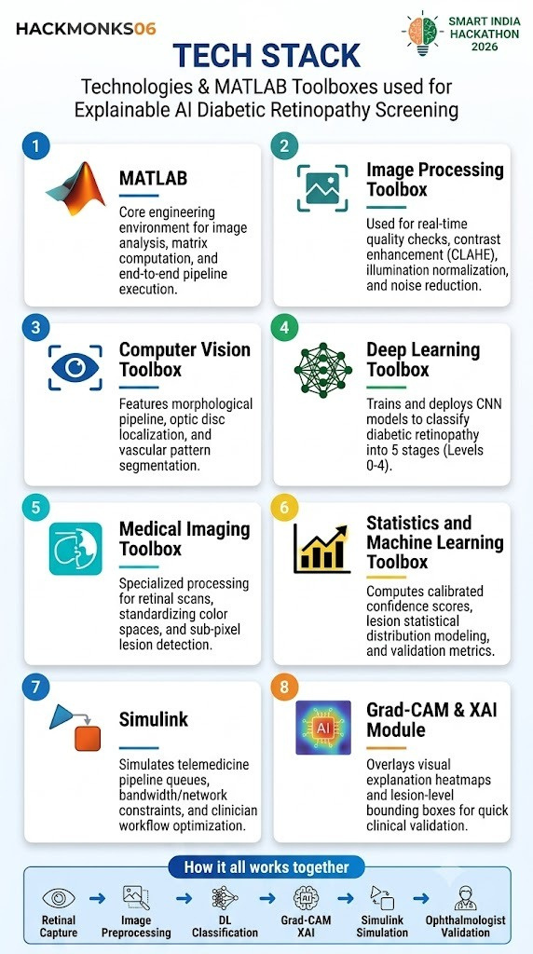
CODE RED
TECHNICAL APPROACH
3

Slide 4
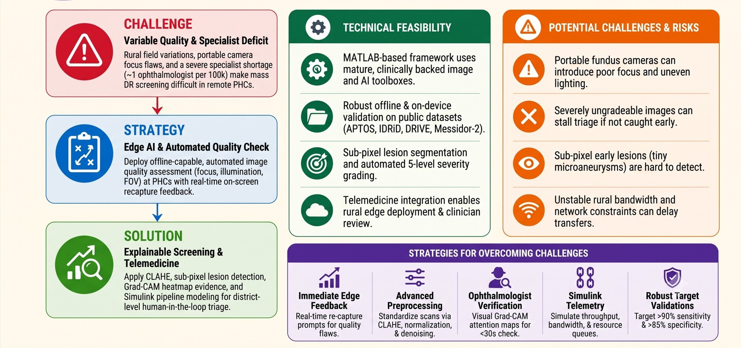
CODE RED
FEASIBILITY AND VIABILITY

Slide 5
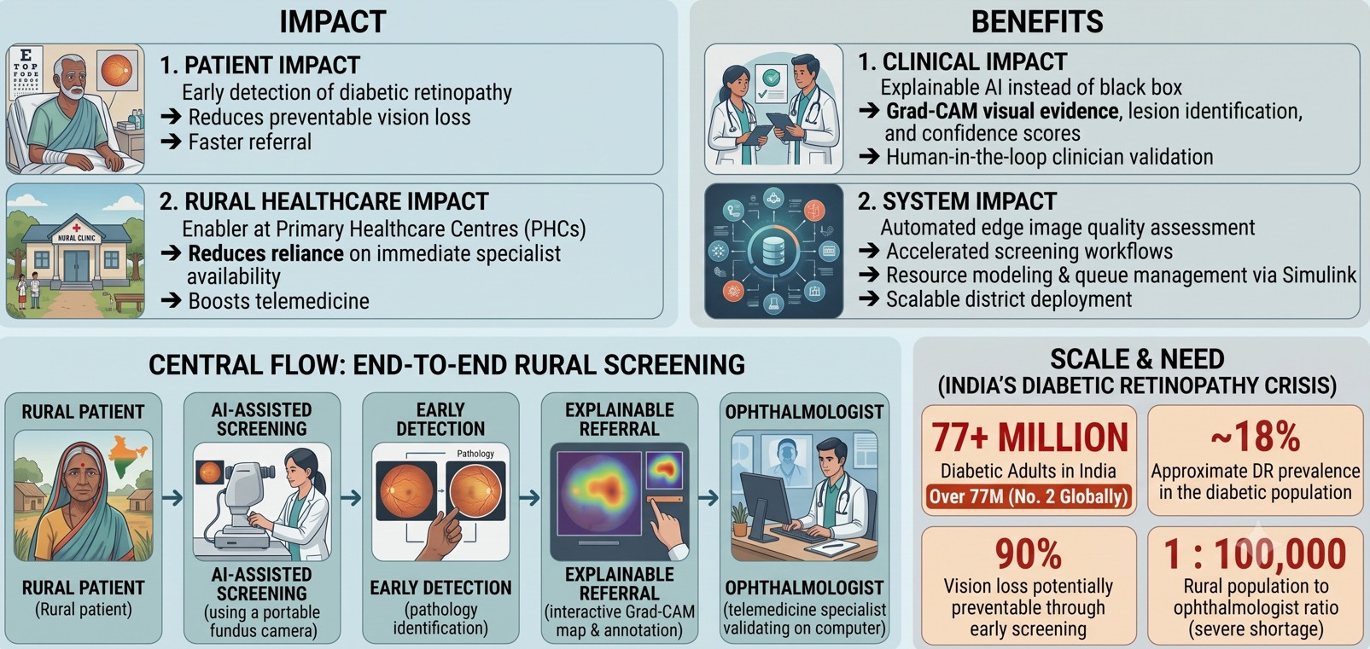
CODE RED
IMPACT AND BENEFITS

Slide 6
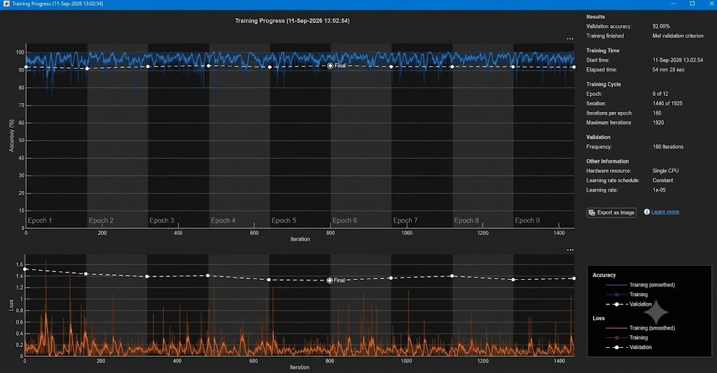
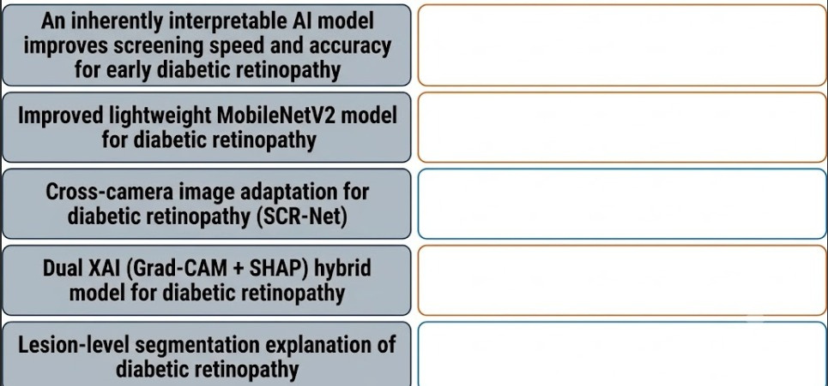
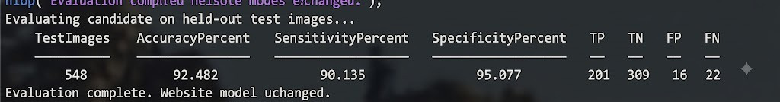
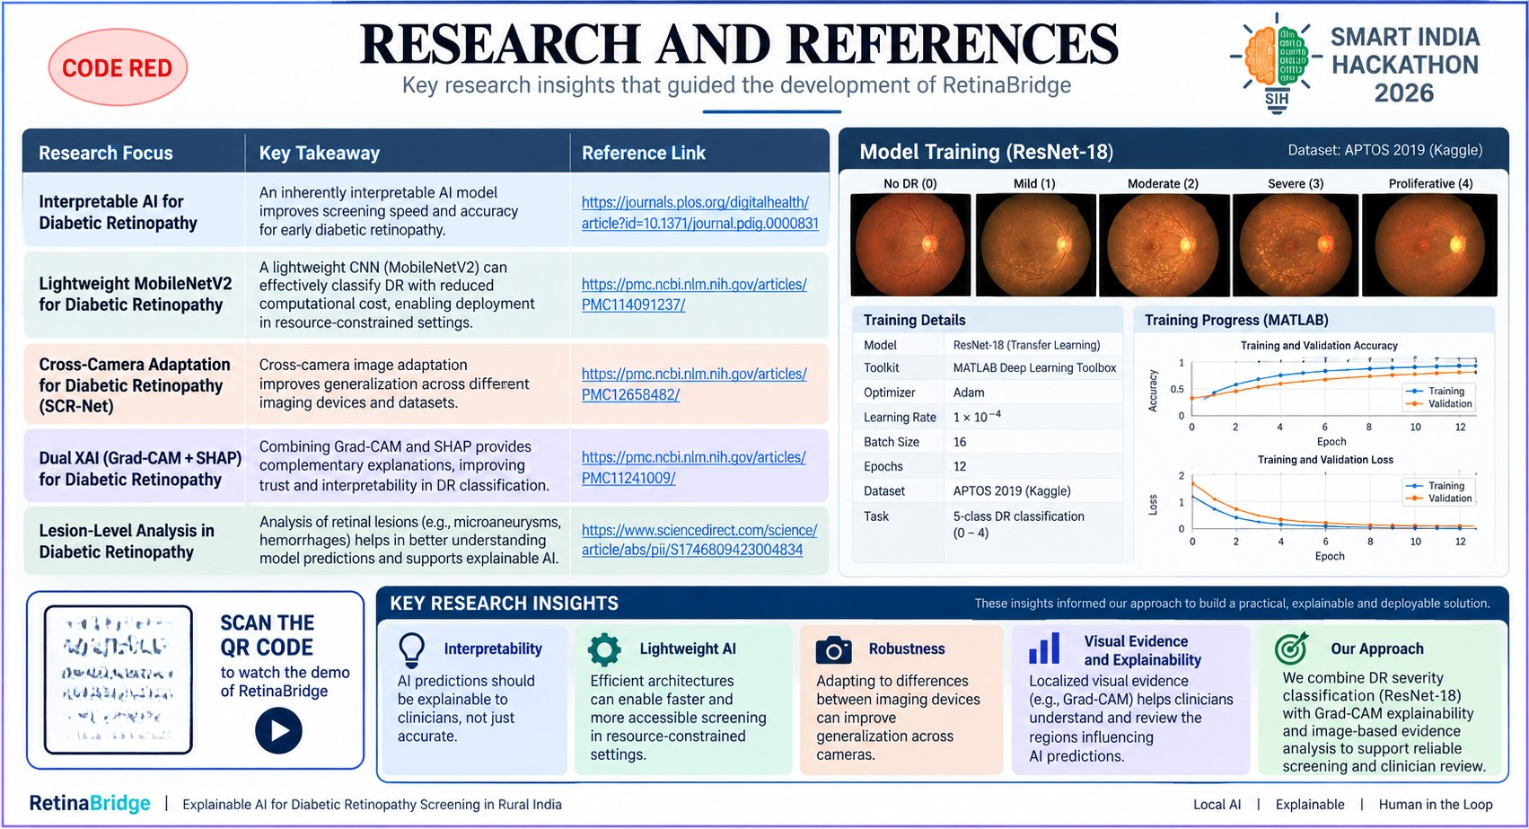

RESEARCH AND REFERENCES
CODE RED
https://journals.plos.org/digitalhealth/article? id=10.1371/journal.pdig.0000831
https://pmc.ncbi.nlm.nih.gov/articles/PMC11409 123/
https://pmc.ncbi.nlm.nih.gov/articles/PMC12658 492/
https://pmc.ncbi.nlm.nih.gov/articles/PMC11241 009/
https://www.sciencedirect.com/science/article/ abs/pii/S1746809423004834

